Slide 1
The paper introduces the task of email subject line generation (SLG), which involves automatically generating concise and informative email subject lines from the email body.

Slide 2
Annotated Enron Subject Line Corpus (AESLC)
The first dataset for email subject line generation (SLG).
Derived from the Enron Corpus
It addresses the unique challenges of email subject generation, such as
high abstraction and
compression ratios.
This dataset enables research into highly abstractive summarization tasks beyond email subjects, such as document section title generation

Slide 3
AESLC Dataset Splits: Training, Validation (Dev) & Test
The Annotated Enron Subject Line Corpus (AESLC) is divided into three datasets: Training, Validation (Dev), and Test.
1. Training Dataset:
Size: 10,570 emails.
Purpose: Used to train the model to learn patterns and relationships between email bodies and their corresponding subject lines.
Features: Emails are preprocessed to remove boilerplate content, filtered to exclude short or redundant emails, and deduplicated to prevent data leakage.
2. Validation (Dev) Dataset:
Size: 1,960 emails.
Purpose: Used to evaluate the model's performance during training, helping to tune hyperparameters and prevent overfitting.
Features: Similar preprocessing as the training set, with each email annotated with three human-written subject lines to account for variability.
3. Test Dataset:
Size: 1,906 emails.
Purpose: Used to evaluate the final performance of the trained model, providing an unbiased assessment of its ability to generate effective subject lines.
Features: Also preprocessed and annotated with three human-written subject lines per email, allowing for comprehensive evaluation against human standards.
These datasets are derived from the Enron Corpus, a collection of emails from Enron employees, and are specifically designed for the task of email subject line generation. The AESLC dataset is notable for its focus on business/personal emails, requiring high abstraction and compression ratios compared to news summarization datasets

Slide 4
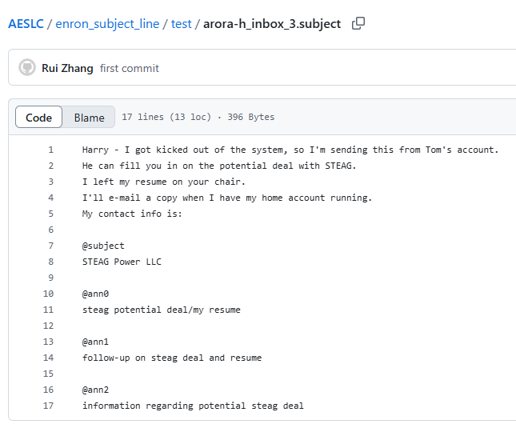
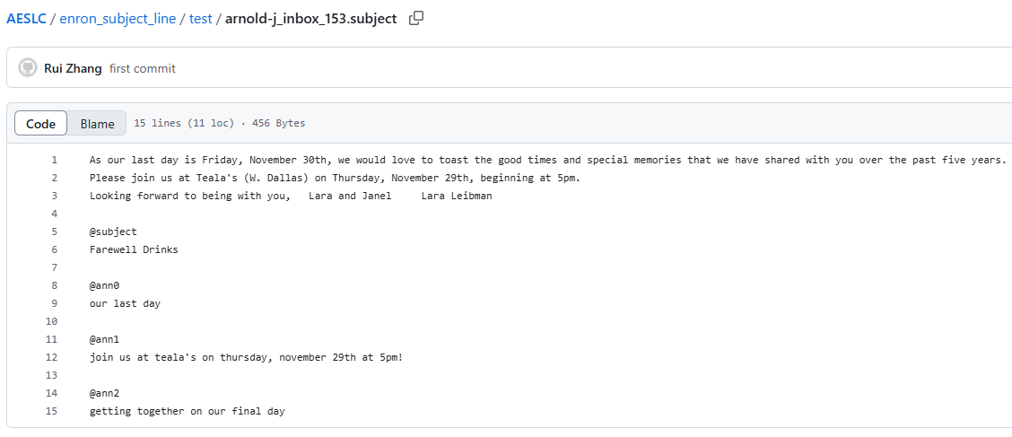
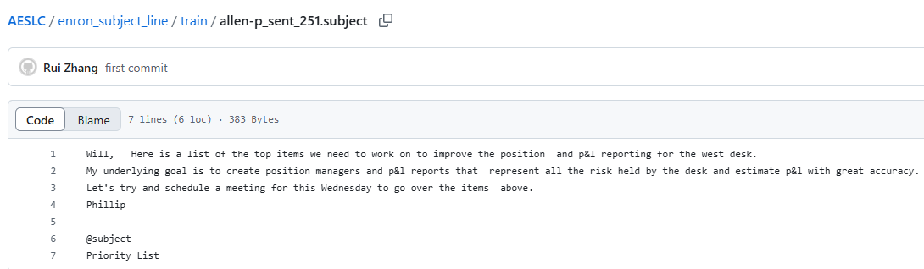


Slide 5
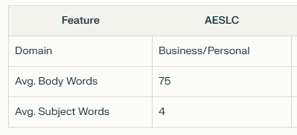
Dataset Creation
The AESLC dataset contains 14,436 emails split into training, validation, and test sets.
Training: 10,570 emails.
Validation: 1,960 emails.
Test: 1,906 emails
Key characteristics:
Domain: Business/personal emails from the Enron Corpus.
Average body length: 75 words.
Average subject length: 4 words (shorter than news headlines)
Compression ratio: ~18:1 (75 words → 4 words), requiring extreme abstraction
Email subjects require higher compression ratios (e.g., compressing 75 words to 4) necessitating extreme abstraction.
Email subjects rely on implicit sender-recipient context (e.g., "Meeting" assumes prior knowledge of the event)

Slide 6
Subject Annotation
For the dev/test sets, each email is annotated with 3 human-written subject lines via Amazon Mechanical Turk to account for variability.
Quality control measures include:
Rejecting vague/generic subjects (e.g., "Update" or "Request").
Ensuring subjects contain body-specific keywords e.g.,
"Current Job Description Needed" instead of "Job Description“,
"Revised Budget Proposal" instead of "Proposal".
Analyzing inter-annotator agreement using ROUGE-L F1 scores (~34 between human annotations)

Slide 7
Preprocessing Steps
Boilerplate Removal: Automatically appended content (e.g., disclaimers, advertisements, attachments) is stripped to retain only the author-written body.
Filtering Criteria:
Emails with fewer than 3 sentences or 25 words are excluded to ensure meaningful content.
Replies/forwards (subjects starting with "RE:" or "FW:") are removed to avoid redundancy.
Deduplication: Identical emails sent to multiple recipients are removed to prevent train-test overlap

Slide 8
Key Challenges
Shared Context: Email subjects often rely on implicit sender-recipient knowledge (e.g., "Request" assumes prior context; "Project Update" assumes familiarity with the project, "Meeting" assumes prior knowledge of the event)), complicating generation.
Subject Variability: Multiple valid subjects exist for the same email, necessitating diverse annotations for evaluation
This preprocessing pipeline enabled the creation of a benchmark dataset for highly abstractive summarization tasks, advancing research in email subject generation and related domains

Slide 9
Model Architecture
The proposed model uses a two-stage extractor-abstractor framework:
Multi-Sentence Extractor: A pointer network selects salient sentences from the email body using hierarchical sentence representations and a bidirectional LSTM.
Multi-Sentence Abstractor: A sequence-to-sequence model with copy mechanisms rewrites the extracted sentences into a subject line. Training involves supervised pretraining followed by reinforcement learning (RL) optimized using a custom Email Subject Quality Estimator (ESQE) as the reward function

Slide 10
Evaluation Metrics
The ESQE metric, a regression-based neural network, predicts subject quality scores by combining CNN-encoded representations of the email body and subject. It achieves a Pearson correlation of 0.64 with human judgments.
Automatic metrics (ROUGE, METEOR, BLEU) and human evaluations show the model outperforms baselines, approaching human-level performance

Slide 11
Results and Insights
This preprocessing pipeline enabled the creation of a benchmark dataset for highly abstractive summarization tasks, advancing research in email subject generation and related domains
Human Evaluation: Subjects generated by the model received an average score of 3.65/4.0, close to human-written subjects (3.82/4.0).
Automatic Metrics: The model outperforms extractive and abstractive baselines, with improvements of up to 4.3 ROUGE-L points.
Challenges: Email subjects often rely on shared context between sender and recipient, complicating generation.
For example, a subject like "Request" is too vague without body-specific details

Slide 12
Applications and Future Work
The authors suggest applications in email triaging and document section title generation.
Future directions include incorporating sender/recipient metadata and exploring few-shot learning for low-resource scenarios

Slide 13
Exploratory Data Analysis

Slide 14
1. Data Cleaning
All Datasets
Text Decoding: Handle character encoding issues.
Lowercasing: Convert all text to lowercase.
Punctuation Removal: Remove punctuation.
Special Character Handling: Remove or replace special characters.
Whitespace Handling: Remove extra whitespace.
Training Dataset
Missing Data: Check and handle missing email bodies or subject lines.
Boilerplate Removal: Use regex or string matching to remove common email footers or signatures.
Length Filtering: Remove very short emails (e.g., < 25 words).
Dev and Test Datasets
Missing Data: Same as training.
Boilerplate Removal: Same as training.
Length Filtering: Same as training.
Ensure Annotation Consistency: check for the quality and relevancy of the annotation

Slide 15
2. Data Preprocessing
All Datasets
Tokenization: Split the text into individual words (tokens).
Stop Word Removal: Remove common words (e.g., "the," "a," "is").
Stemming/Lemmatization: Reduce words to their base form.
Vectorization: Convert the text data into numerical vectors.
TF-IDF (Term Frequency-Inverse Document Frequency): Weight words by importance.
Word Embeddings (Word2Vec, GloVe, BERT embeddings): Capture semantic meaning.

Slide 16
3. Data Analysis
Training Dataset
Email Length Distribution: Analyze the distribution of email body lengths to understand the dataset's characteristics.
Vocabulary Analysis: Identify the most frequent words in the email bodies and subject lines to gain insights into common topics.
Dev and Test Datasets
Annotation Analysis: Check the distribution and variability of annotations in these datasets. Check the distribution of key words, semantic similarity, and subject relevancy with mail body

Slide 17
4. Importance of Training & Test Dataset
To generate subject lines for a given email, you should train your model using the training dataset and evaluate it using the test dataset.
Therefore, your file reading process should consider this split:
Training Phase: Read and process all files from the training directory to train your subject line generation model.
Testing Phase: When you want to generate a subject line for a new email (or evaluate your model), you'll read and process the relevant files from the test directory (or a separate set of unseen emails).

Slide 18
5. Importance of Dev Dataset
The dev dataset is used for validation. During the training process, you'll use the dev dataset to:
Tune Hyperparameters: Adjust settings like learning rate, batch size, etc., to optimize model performance.
Monitor Overfitting: Check if the model is starting to memorize the training data instead of learning general patterns. Performance on the dev set will degrade if overfitting occurs.
In essence, the dev dataset acts as a "practice test" for your model during training, allowing you to make adjustments and improvements before the final evaluation on the test data.

Slide 19
6. Use of each dataset in email subject line generation project
Training Dataset:
Purpose: To train your machine learning model.
Action: The model learns the relationship between email bodies and their corresponding subject lines.
Dev (Validation) Dataset:
Purpose: To evaluate the model's performance during training and fine-tune hyperparameters.
Action: Use it to prevent overfitting and adjust model settings.
Test Dataset:
Purpose: To assess the final performance of your trained model.
Action: Provides an unbiased evaluation of the model's ability to generate subject lines for unseen emails.

Slide 20
Overall Goals of EDA
Understand the characteristics of the email data.
Identify patterns and relationships between email bodies and subject lines.
Uncover potential issues or biases in the data.
Guide feature engineering and model selection.

Slide 21
EDA - Training Dataset
The goal is to learn the relationship between the mail and its subject.
Basic Statistics:
Number of files
Email Body Analysis:
Average Length.
Distribution of Lengths.
Most Frequent Words.
Top N-grams.
Subject Line Analysis:
Average Length
Distribution of Lengths.
Most Frequent Words.
Top N-grams.
Email Body and Subject Line Relationships:
Correlation between email body length and subject line length.
Common words and phrases in both email bodies and subject lines.
Examples of email bodies and their corresponding subject lines.
Check to see Subject contains mail key words

Slide 22
Dev and Test Datasets
The goal here is to check if the data suits the requirements and the quality of annotations
Basic Statistics:
Number of files.
Email Body Analysis:
Average Length.
Distribution of Lengths.
Subject Line Analysis:
Average Length.
Distribution of Lengths.
Annotation Analysis:
Annotation Lengths Distribution
Vocabulary Overlap Between Annotations
Annotation Diversity: Are annotations similar or do they capture different aspects? Calculate pair-wise similarity scores (e.g., cosine similarity of TF-IDF vectors) between annotations for the same email.
Email Body vs. Subject Line/Annotations: * Relevance of Subject Lines and Annotations: Check how much overlap in keywords there is between the email body, the generated subject line, and the provided annotations
Human Performance Baseline: * Use the multiple human annotations in the dev/test sets to establish a "human performance" baseline. Compare the automatic metrics (ROUGE, etc.) between the annotations to get an estimate of human-level performance.

Slide 23
Implementation Notes
Libraries: Use libraries like nltk, scikit-learn, matplotlib, and seaborn for text processing, analysis, and visualization.
Iterate: Read data in chunks if the dataset is large to avoid memory issues.
Visualize: Use histograms, box plots, word clouds, and other visualizations to explore data characteristics.

